Slide 1
CUSTOMER RELATIONSHIP MANAGEMENT
CONCEPTS AND TECHNOLOGIES
Chapter 1: Introduction to CRM

Slide 2
Selected definitions of CRM 1
CRM is an information industry term for methodologies, software, and usually Internet capabilities that help an enterprise manage customer relationships in an organized way.
CRM is the process of managing all aspects of interaction a company has with its customers, including prospecting, sales, and service. CRM applications attempt to provide insight into and improve the company/customer relationship by combining all these views of customer interaction into one picture.

Slide 3
Selected definitions of CRM 2
CRM is an integrated approach to identifying, acquiring, and retaining customers. By enabling organizations to manage and coordinate customer interactions across multiple channels, departments, lines of business, and geographies, CRM helps organizations maximize the value of every customer interaction and drive superior corporate performance.

Slide 4
Selected definitions of CRM 3
CRM is an integrated information system that is used to plan, schedule and control the pre-sales and post-sales activities in an organization. CRM embraces all aspects of dealing with prospects and customers, including the call center, sales force, marketing, technical support and field service. The primary goal of CRM is to improve long-term growth and profitability through a better understanding of customer behaviour. CRM aims to provide more effective feedback and improved integration to better gauge the return on investment (ROI) in these areas.

Slide 5
Selected definitions of CRM 4
CRM is a business strategy that maximizes profitability, revenue and customer satisfaction by organizing around customer segments, fostering behaviour that satisfies customers, and implementing customer-centric processes.“

Slide 6
Four types of CRM
Type of CRM | Dominant characteristic
Strategic | Strategic CRM is a core customer-centric business strategy that aims at winning and keeping profitable customers.
Operational | Operational CRM focuses on the automation of customer-facing processes such as selling, marketing and customer service.
Analytical | Analytical CRM focuses on the intelligent mining of customer-related data for strategic or tactical purposes.
Collaborative | Collaborative CRM applies technology across organizational boundaries with a view to optimizing company, partner and customer value.

Slide 7
Customer centricity and other business logics 1
Product-oriented businesses believe that customers choose products with the best quality, performance, design or features.
Production-oriented businesses believe that customers choose low-price products.
Sales-oriented businesses make the assumption that if they invest enough in advertising, selling, public relations (PR) and sales promotion, customers will be persuaded to buy.

Slide 8
Customer centricity and other business logics 2
A customer or market-oriented company shares a set of beliefs about putting the customer first. It collects, disseminates and uses customer and competitive information to develop better value propositions for customers. A customer-centric firm is a learning firm that constantly adapts to customer requirements and competitive conditions.

Slide 9
Operational CRM
Marketing automation
 | Market segmentation
 | Campaign management
 | Event-based (trigger) marketing
Sales force automation
 | Account management
 | Lead management
 | Opportunity management
 | Pipeline management
 | Contact management
 | Quotation and proposal generation
 | Product configuration
Service automation
 | Case ( incident or issue) management
 | Inbound communications management
 | Queuing and routing
 | Service level management

Slide 10
Sources of customer-related data for analytical CRM
Internal sources
  Sales data (purchase history), financial data (payment history, credit score), marketing data (campaign response, loyalty scheme data) and service data.
External sources
  Geo-demographic and life-style data from business intelligence organisations, for example.

Slide 11
Beneficiaries of analytical CRM
Customer
  Analytical CRM can deliver timely, customized, solutions to the customer’s problems, thereby enhancing customer satisfaction.
Company
  Analytical CRM offers the prospect of more powerful cross-selling and up-selling programs, and more effective customer retention and customer acquisition programs.

Slide 12
Misunderstandings about CRM
CRM is database marketing
CRM is a marketing process
CRM is an IT issue
CRM is about loyalty schemes
CRM can be implemented by any company

Slide 13
Core definition of CRM
CRM is the core business strategy that integrates internal processes and functions, and external networks, to create and deliver value to targeted customers at a profit. It is grounded on high quality customer-related data and enabled by information technology.

Slide 14
CRM constituencies
Companies implementing CRM
Customers and partners of those companies
Vendors of CRM software
CRM application service providers (ASPs)
Vendors of CRM hardware and infrastructure
Management consultants

Slide 15
CRM challenges vary across context
Banks
Auto manufacturers
High tech companies
Consumer goods manufacturers
Not-for-profits

Slide 16
The IDIC model of CRM
Identify who your customers are and build a deep understanding of them
Differentiate your customers to identify which customers have most value now and which offer most for the future.
Interact with customers to ensure that you understand customer expectations and their relationships with other suppliers or brands
Customize the offer and communications to ensure that the expectations of customers are met.

Slide 17
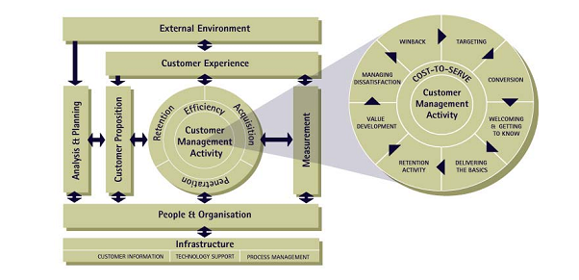
The QCi model of CRM

Slide 18
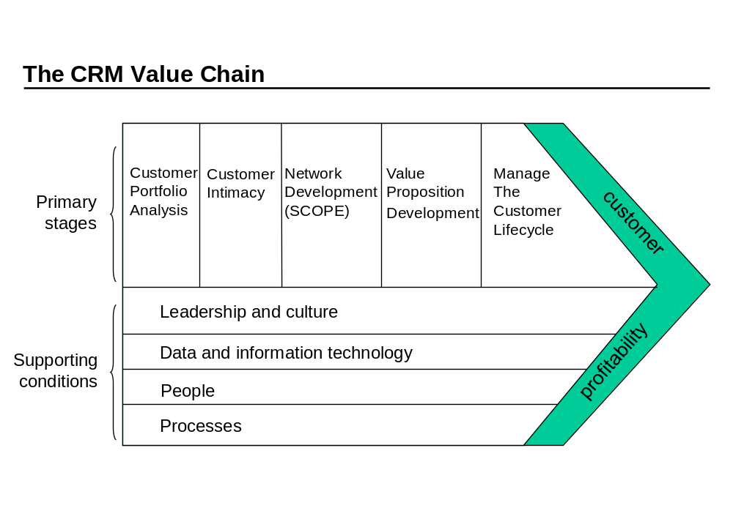
The CRM Value Chain

Slide 19
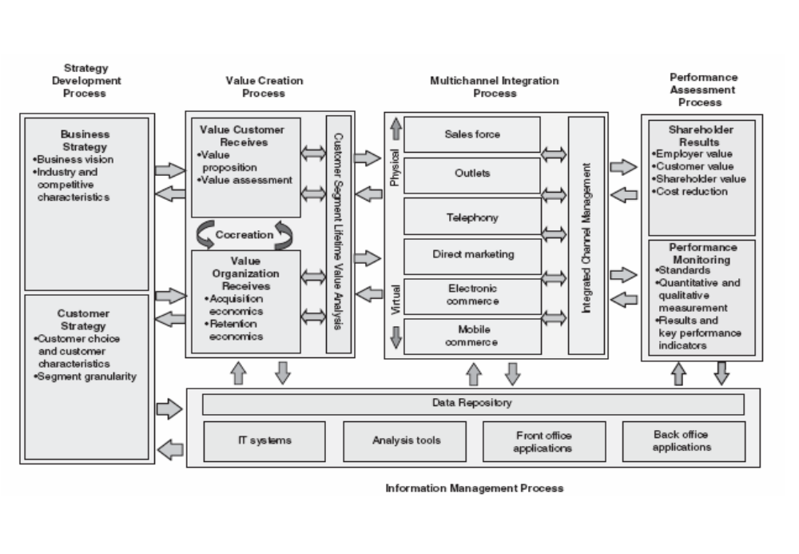
Payne’s 5-process model of CRM

Slide 20
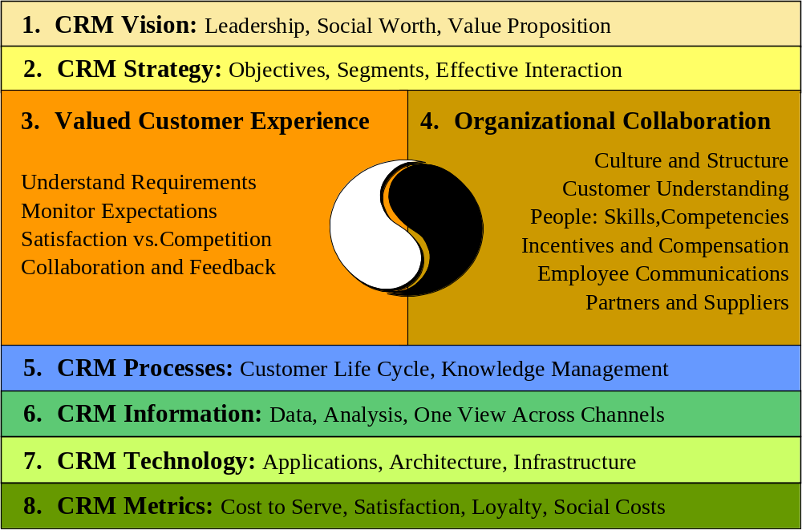
Gartner’s competency model of CRM

